Slide 1
Intro to Scripting
Mack 2023

Slide 2
Learning Objectives
Understand the concept of scripting in game development.
Learn how to create a script in the FileSystem.
Understand the purpose of variables and operators in scripting.

Slide 3
Intro to Scripting
Scripting is a powerful tool that allows us to create gameplay behaviors and logic for our game. It is done by creating a Script in the FileSystem, which is essentially a text document filled with code that we can then attach to a node, via the Script property, which every node has. Our code will then affect the node directly, doing things like influencing the player’s position or acting as an enemy AI.

Slide 4
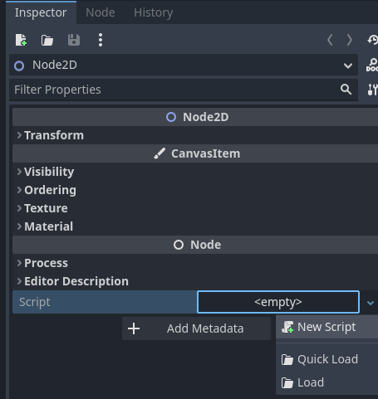
Creating a Script
To create a script, we first want to choose the node to add a script to. As we are using a new scene, we will use the Node2D root note. In the Inspector there is a Script property in which you can select New Script from the dropdown.

Slide 5
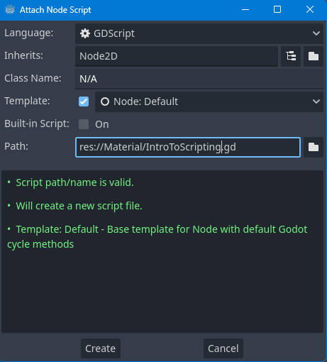
Creating a Script
This will open up the Attach Node Script window, where we can modify some settings. For our script, we just want to go down to where it says path and change the name of our script, for this script we will name it IntroToScripting.gd.

Slide 6
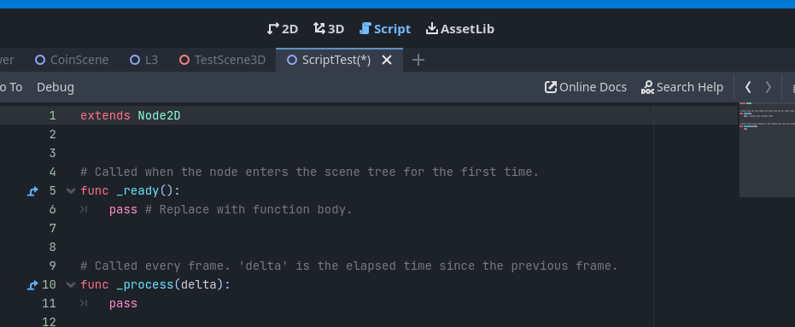
Creating a Script
You can then click the Create button to add the script to the node, along with creating the script in the FileSystem. We will also automatically be moved over to the Script Editor tab, which can be accessed in the same place we switch between the 2D and 3D views.

Slide 7
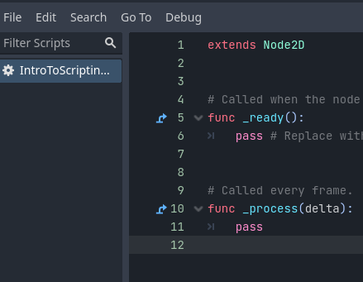
Script Editor
The Script Editor is where we can write down our code. It is a text editor specifically designed for GD Script, which is the scripting language designed specifically for Godot. By default, you will notice there is some code already in the document, which is standard when creating a new script in Godot.
On the left of the editor, you will find two lists, one for the Scripts in the project, and another for the Methods in the current script, which are something we will cover in a future lesson.

Slide 8
Script Editor
The editor also has code formatting, which means that certain things are different colors. This makes it easier to look at and identify certain things, such as a function keyword being in red and a function name being in blue.
It also has auto-correct, which means that when you’re writing down code, it tries to estimate what you want to do and pop up with a window as you type with options. This can help speed up your programming and also allows you to find certain things when you’re not quite
sure what the name is.
Make sure to save this (CTRL+S) and in the next lesson, we will cover the concept of variables.

Slide 9

Variables
Variables are an important concept in programming, they are pieces of data that you can define, read, and change the value to store information.
Variables can be thought of as boxes, with a name and a value, which at any time we can find the box from its name and use the value in the box.

Slide 10
Variables
There are different types of variables, which include:
Whole numbers (1, 2, 3)
Decimal numbers (0.1, 2.7, 3.6)
Text (“Hello World”)
Booleans (True / False)
And more…

Slide 11
Creating our First Variable
To create a variable in GD Script, we first need to define it. When programming, we write the variables at the top of the script, so we will define all our variables below the extends Node2D line.
To define our first variable we will write the keyword var to specify this is a variable. This will be followed by the name of the variable (we will use the name score), an equals sign, and then the default value of the variable, which we will use a value of 0.
var score = 0

Slide 12
Creating our First Variable
To test this variable, we can log the value to the game’s output. To do this we will use the _ready function. We will cover functions further in this course, however for now, just know functions are blocks of code that can be called at any time. The _ready function will be called at the start of
the game.
In the function, we will replace the pass line with our own code to print the score variable to the screen.
func _ready():
print(score)

Slide 13

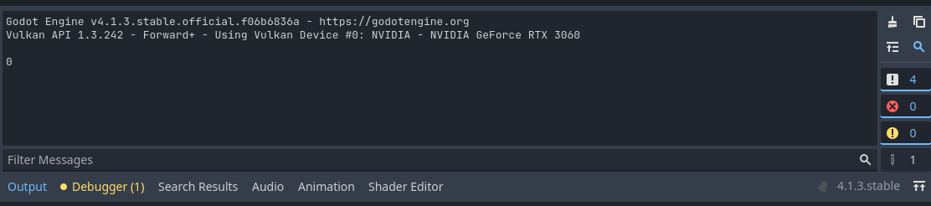
Creating our First Variable
Printing a value like this is also extremely helpful for finding issues with your code. Now we can save the script (CTRL+S) and press the Play button.
Notes:
You will then find that 0 is printed to the Output window, as this is the value we gave to the score variable.
If you then change the value of the score variable and run the scene again, you will see the output has changed

Slide 14
Working with Variable Types
As GD Script is a dynamic programming language, we don’t have to specifically design the type of variable we want to use. This can allow a lot of flexibility when writing the code, however, it is generally best practice to define the data types of your variables, so that GD Script knows specifically the type of variable you want.
Currently, we have the score variable, which stores a whole number value (1, 2, 3). To specify that this variable will store a whole number, and only a whole number, we will add an integer definition after the variable name. This is done by writing “: int” after the world score.
var score : int = 5

Slide 15
Working with Variable Types
Another variable type is a float. A float can store a decimal number, this can be useful for storing values like a player’s movement speed. To create a new variable using a float data type we will write a new line of code.
var move_speed: float = 2.53

Slide 16
Naming Variables
It is important to note the way we write variable names. We have used only lowercase and an underscore where there would be a space, which is known as Snake Case.
This is because you can not have a space in a name in programming, as GD Script won’t understand that. The name “move speed” will not work, but the names “move_speed” or “moveSpeed” can be used as they contain no
spaces.
You don’t specifically have to write in Snake Case, especially in other programming languages, however, it is generally considered the standard for writing code in GD Script.

Slide 17
Working with Variable Types
A boolean is another type of variable used in programming, and they are used to store a value of true or false. In this example, we will use it to store a variable called game_over, which is something you may want to have an on/off state.
var game_over : bool = true

Slide 18
Working with Variable Types
The final type of variable we will cover is a String. A String is used to store text. When defining a String it is important to use a capital letter at the start of the data type, which is different from the other data types we have covered. We will use this variable to store an ability.
var ability : String = "slash"

Slide 19
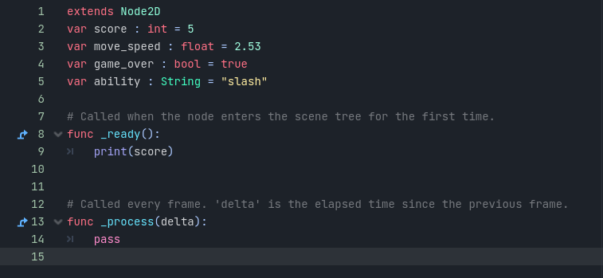
Working with Variable Types
You will notice that with Godot’s formatting the string will be highlighted in a gold-yellow color so that they can be easily identified in the Script Editor.

Slide 20

Modifying Variable Values
Another key feature of variables is that they can be modified after their definition. To do this, we will change the print line to log our move_speed variable instead.

Slide 21
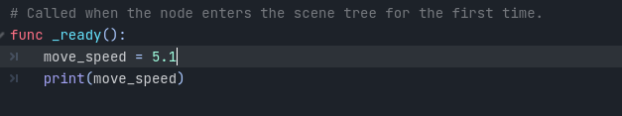
Modifying Variable Values
If you Save and press Play you will see a value of 2.53 in the Output window. What we can now do is change the value before we print the move_speed variable, we will change it to a value of 5.1.
Notes:
If you now Save and press Play you will see the 5.1 value is printed to the Output window as we have overwritten the original value.

Slide 22
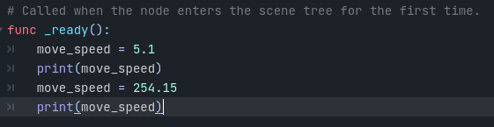
Modifying Variable Values
In basically every programming language, there is an order of execution. This means that everything runs one command at a time, in GD Script commands are individual lines. This means that when the _ready function is called, each line is run one at a time from the top to the bottom. This allows us to change the value (to something like 500.156) and print it out again, all in the same function.

Slide 23
Operators
Operators are symbols that tell the computer to perform certain mathematical operations, very similar to a mathematical equation on paper. In GD script, the four main operators are addition, subtraction, multiplication, and division. These operators can be used to modify variables or change the behavior of a script.

Slide 24
Addition
Notes:
The addition operator is used to increase the value of a variable by a specified amount. To try this in Godot, we will first need to create a variable named score. As we are working with whole numbers, we will make it of type int and with an original value of 0.

Slide 25
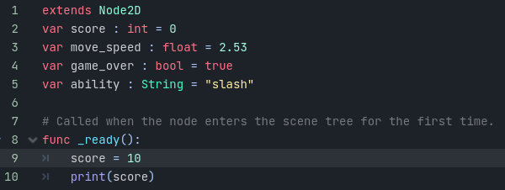
Addition
Notes:
In the _ready function we can then print the score so we know what it has started as. If you run the script now, you will see an output of 0. As we covered previously, you can set the score using the equals sign. Here, the equals sign is known as an assignment operator, meaning it will assign the variable to a new value.

Slide 26
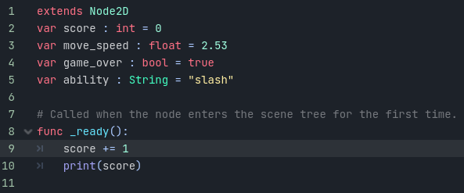
Addition
Notes:
This works if you know exactly what number you would like to set score to, but in many cases, you may want to increase score by a specific amount, like if the player picks up a coin for example. To do this we use both the plus and equals signs.
If you now Save the script and press Play you will see 1 is printed to the Output.

Slide 27
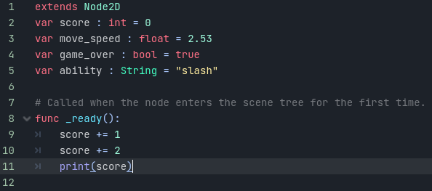
Addition
Notes:
You can then add another plus-equals line to increase the score further before printing.
In this case, if you press Play you will see the score outputs as 3, as 0 + 1 + 2 = 3.

Slide 28
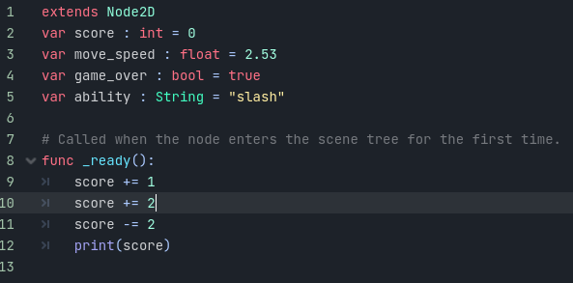
Subtraction
Similarly to addition, we also have a subtraction operator. To do this use the minus-equals operator to take a value away from score. In this case, we will add this under our addition section to keep changing score’s value.
Notes:
If you now press Play you will see our previous 3, minus 2 to output 1 to the screen.

Slide 29
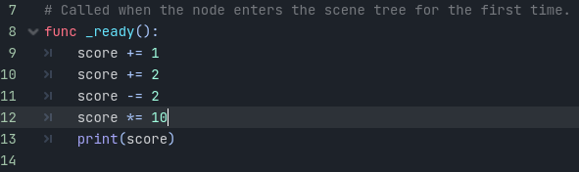
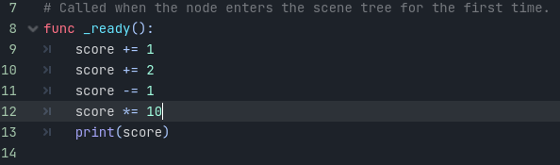
Multiplication
The multiplication operator is used to multiply the value of a variable by another value. We use the asterisk symbol (*) to denote multiplication in programming languages. Like with addition and subtraction, you can also place this before the assignment operator (=) to set a variable directly to
the new multiplied value. Here we will multiply the score variable by 10 to see the results.
Notes:
This will then output a value of 10 as expected.
We can change the subtraction example to – 1 instead of – 2 to make our output 20 instead.

Slide 30
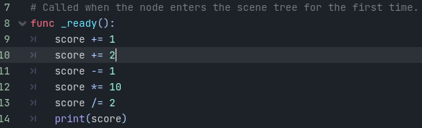
Division
The final operator we will cover is the division operator. This operator uses the forward slash symbol (/). In this case, we can also use it with the assignment operator to apply the changes directly to score, we will divide our score variable by 2 in this example.
Notes:
As our last output was 20, this will therefore give us an output of 10 when you Play the scene.

Slide 31
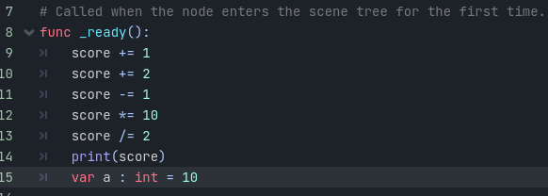
Using Variables
In addition to setting the score variable directly, we can use another variable to change the value used by our operators. We can do this by creating an integer variable called a in the _ready function.

Slide 32
Using Variables
It is important to note the scope of a variable when doing this. Since we create variable a inside of a function, we can only access a from inside the _ready function.
This is because once the _ready function has run through, the variable a no longer exists, so it can’t be accessed outside this function.
As score is created outside of any function, it is accessible across the whole script, this is known as a global variable.

Slide 33
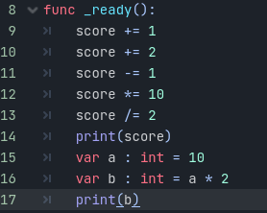
Using Variables
We can then create another variable, b, that will be double the value of a. We can do this by using the multiplication operator on the value of a when we are assigning it.
Notes:
Here we only use only the multiplication symbol, not multiplication-equals. This is because we don’t want to change the value of a, we only want to use it for multiplication, so we don’t use the assignment operator.

